Slide 1

Quantum-AI
Smart Doorbell Application
Professors: Kakani Vijay & Baydadaev Shokhrukh
Date: 2022/11/27

Slide 2
Plans
Introduction
Team members and their roles
Timeline of creating the application
The main functions & working process of the application
Comparisons of the applications
01
Body 1
Implementation of face recognition
Implementation of emotion detection
Implementation of messenger Telegram
Difficulties during coding and implementation
02
Body 2
3D model of the application
Detailed drawing of the 3D model
Animated video of the 3D model
03
Conclusion
Skills that we gained during IOT class
References
04

Slide 3

Meet Our Team
Javokhir Jambulov 12204567 (leader)
Role: Coding and implementation
Saidmurodov Elyor 12204556
Role: Application concept & presentation making
Example Text : Get a modern PowerPoint Presentation that is beautifully designed. I hope and I believe that this Template will your Time, Money and Reputation. Get a modern PowerPoint Presentation that is beautifully designed. I hope and I believe that this Template will your Time, Money and Reputation. You can simply impress your audience and add a unique zing and appeal to your Presentations.
Alexis Cerna 12224944
Role: Coding and implementation
Abror Khasanov 12204542
Role: 3D design and modeling concept
Ogabek Tulaev 12194910 Role
Coding and implementation

Slide 4
Timeline of Smart Doorbell
Step 4
Step 3
Step 2
Step 1
Deep research based on the Smart doorbell
Raspberry file and open cv installation
Dividing the group roles
Brainstorming within group members
2020
Step 5
Step 6
Step 7
Coding and implementation
Troubleshooting & bug fixes
Last improvements on the project
Smart Doorbell

Slide 5
Smart Doorbell
Main Functions of the application
Smart doorbell is an application, which can detect a person and send the face of the person next to the door to the telegram of the house owner with the emotion information.
Ability to capture the person’s face
Emotion detection
Sending the data to telegram
Ability to recognize people
As it can also recognize the people, the house owner will be aware when the family members, neighbors, delivery person and others come to the house.

Slide 6
Working process of Smart Doorbell
Sending the data to telegram
Lastly, the taken picture and the emotion information will be delivered to the house owner within a second
Detecting the person’s face
When the person comes to the house next to the Smart Doorbell, it instantly detects the person’s face
Capturing the person’s face
Smart Doorbell
After detecting the person’s face it captures and saves the picture
Emotion detection
As the person looks to the camera of the Smart Doorbell, it detects the emotion of the person

Slide 7
Comparisons to other doorbells
Fast and simple notification about the visitor
Face recognition and emotion recognition
While most doorbells require specific application, our Smart Doorbell sends the data to the Telegram messenger in a very short time. So that, any additional apps are not required to use this application.
As the most doorbells with cameras only detects the person, our application Smart Doorbell not only detects the person, it also recognizes the visitor’s face and informs the owner about the visitor's emotion as well.
Mass producible product
As the Smart Doorbell application consists of a single camera and the small raspberry file with very simple codes, it is possible to manufacture the product under low costs with lots of quantity.

Slide 8
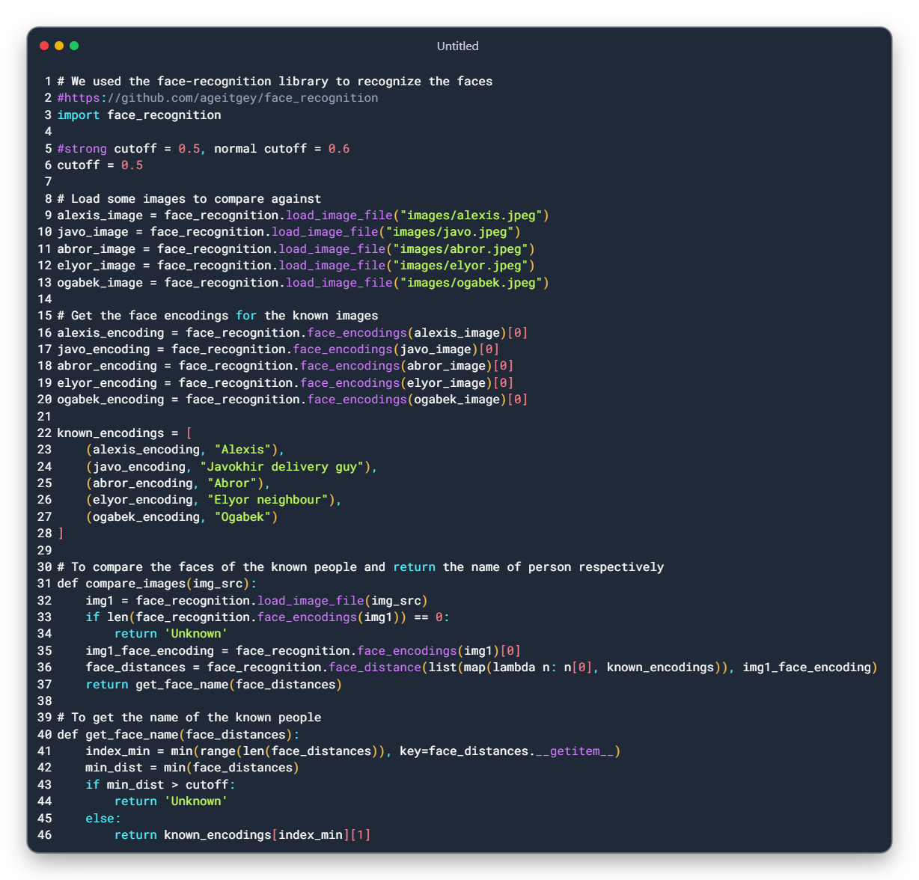
Face Recognition

Slide 9
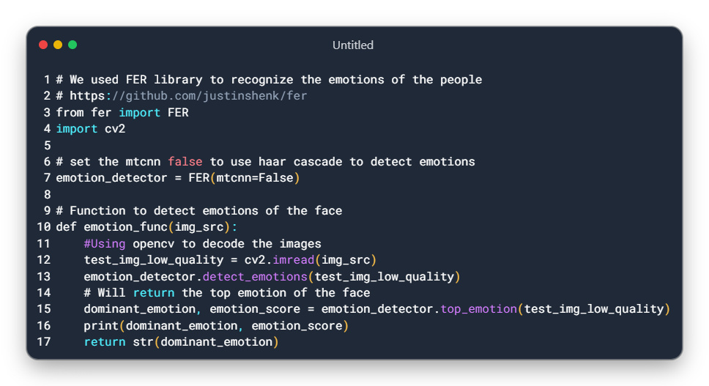
Emotion Detection

Slide 10
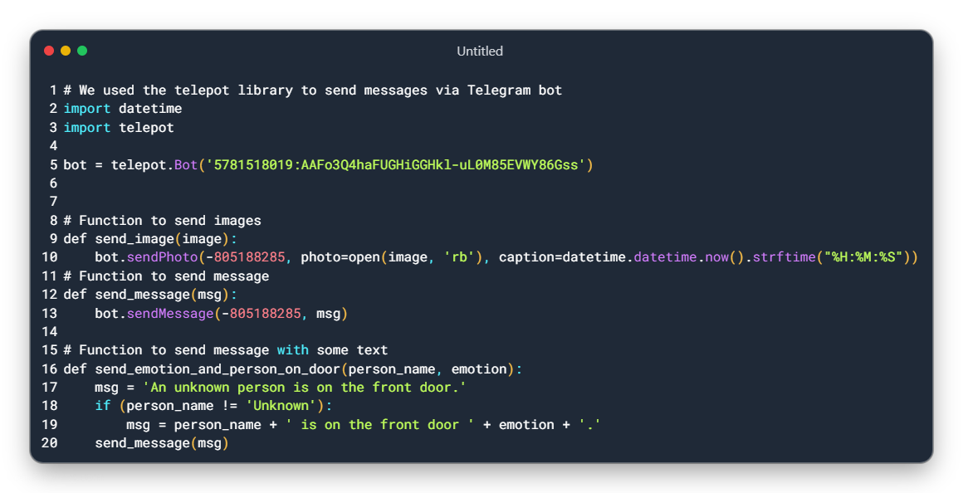
Telegram messenger

Slide 11
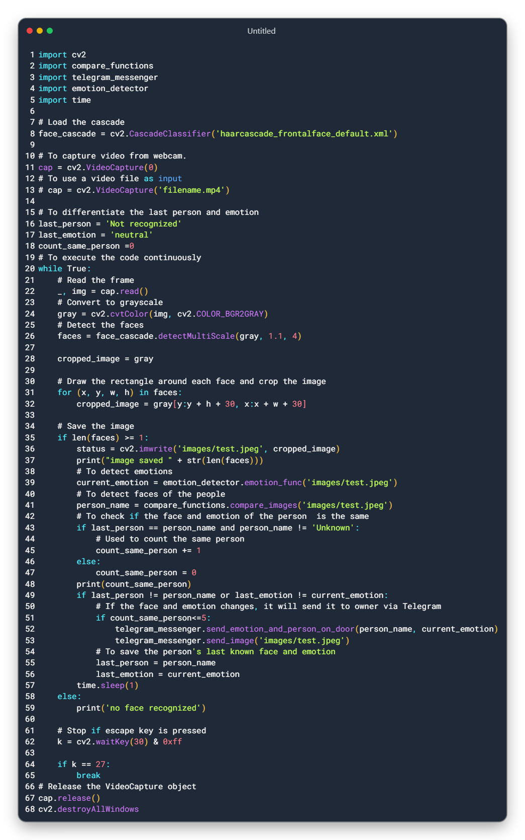
Main file

Slide 12
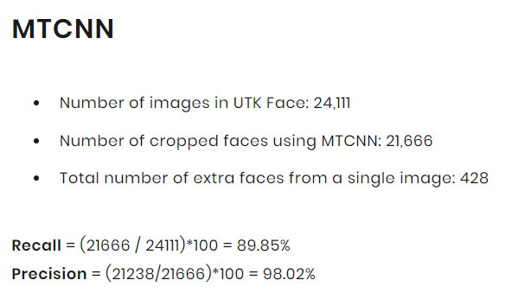
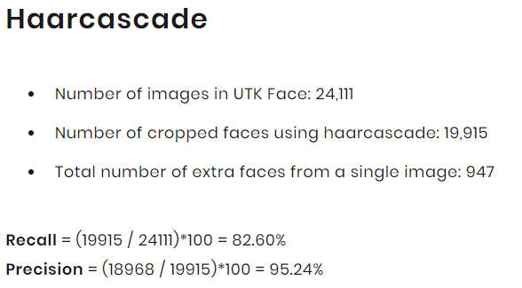
Difficulties during coding and installation
During Coding:
1. Changing the picture from RGB to Grayscale
2. Cropping the image around the face of the person
3. Sending the image of the same person with same emotion for multiple times
4. Sending too many requests on Telegram bot
5. Detecting emotions using Multi-Task Cascaded Convolutional Neural Network (MTCNN)
During Installation on Raspberry Pi:
1. Installing Tensorflow on 32-bit Raspberry pi os, so we installed 64-bit os
2. We used dlib for face detection and facial landmark detection, which is used for emotion recognition too. It took a lot of time.
3. Installing opencv on 64-bit os, during installation it got stuck at 99% for 3+ hours

Slide 13
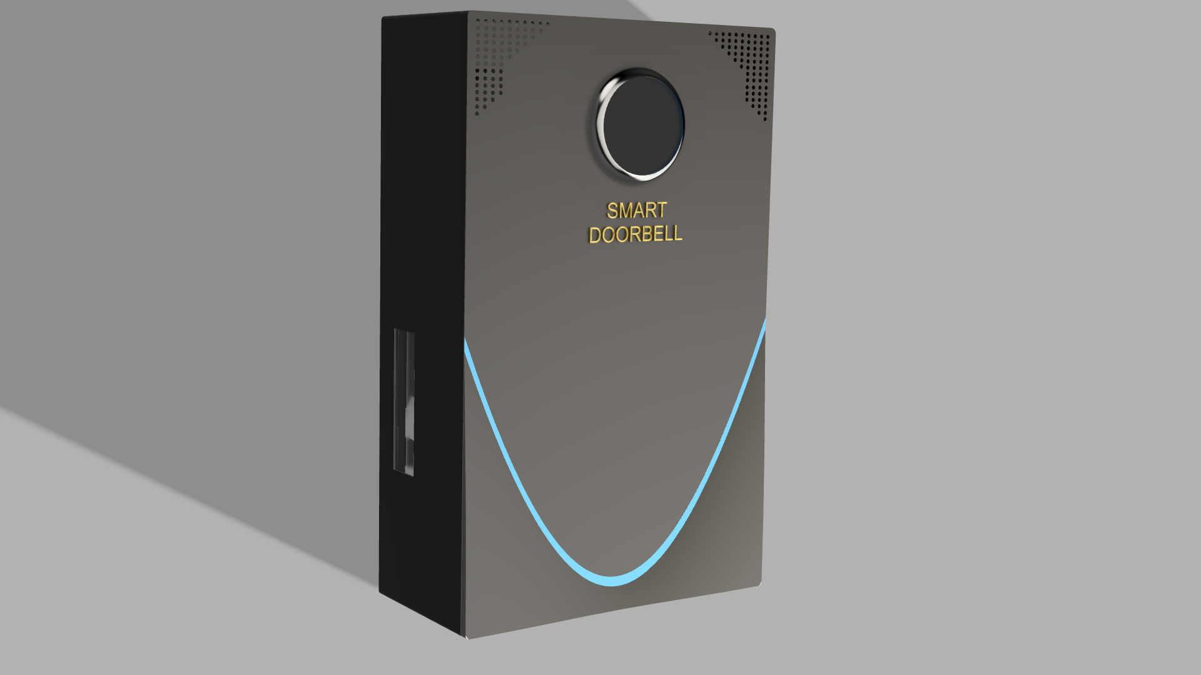
3D model of Smart Doorbell

Slide 14
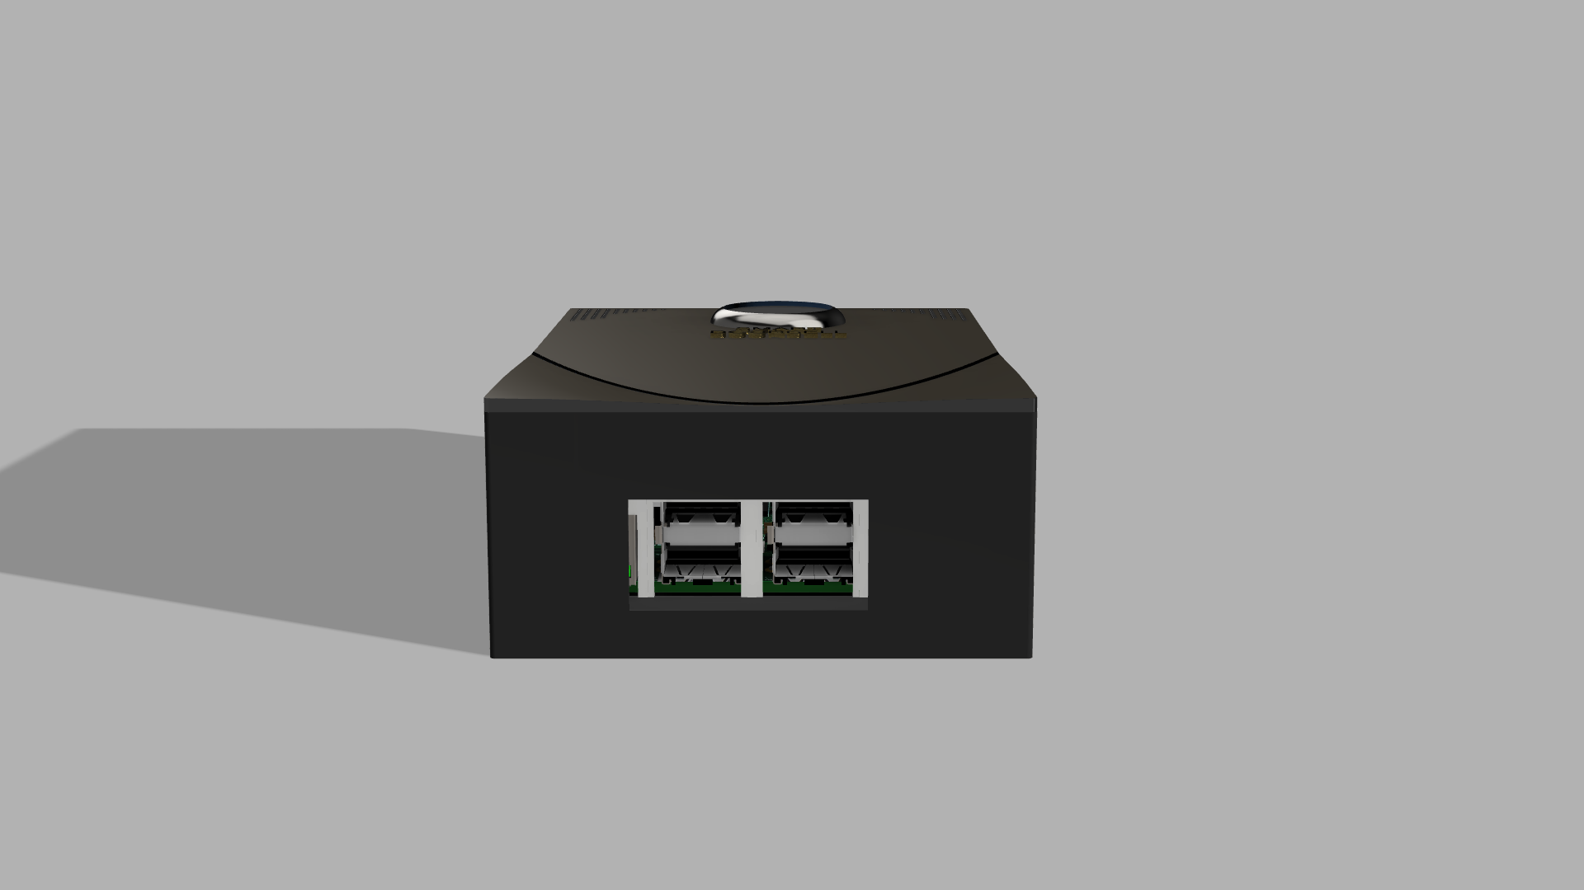
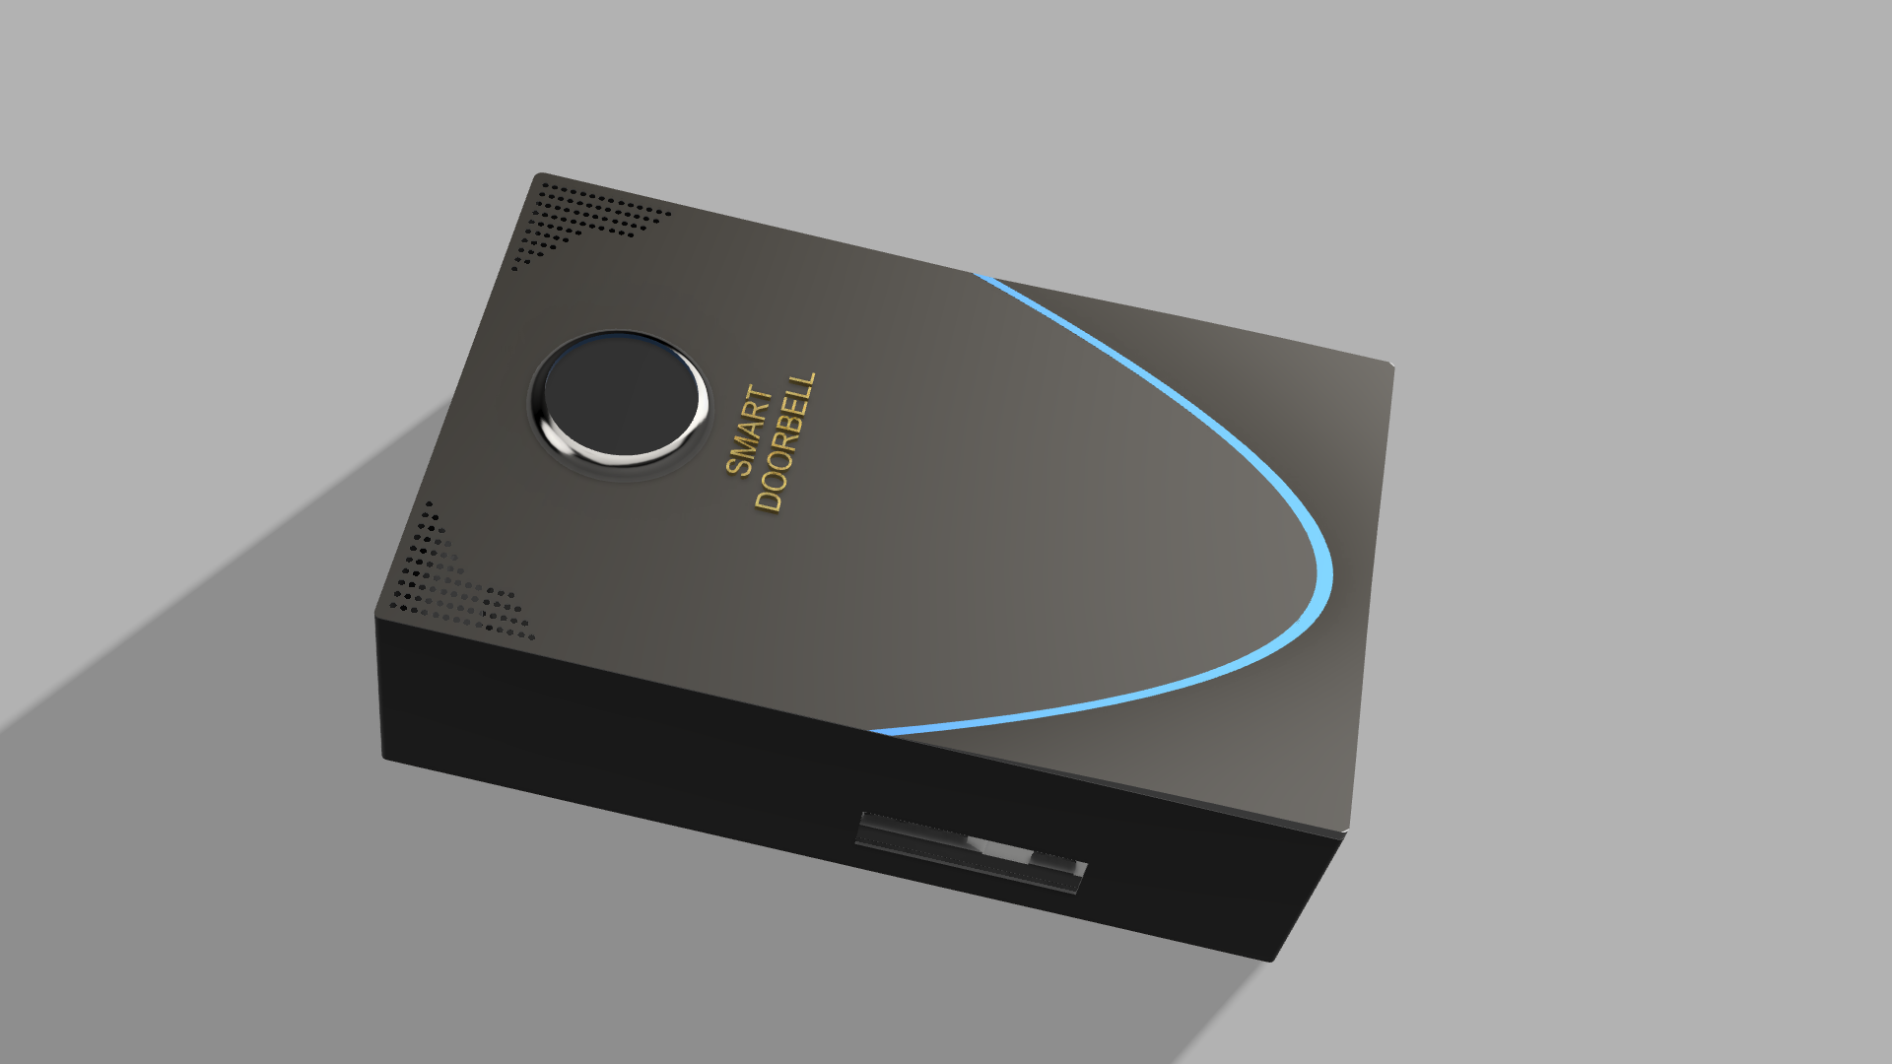
Back and side views of the 3D model

Slide 15
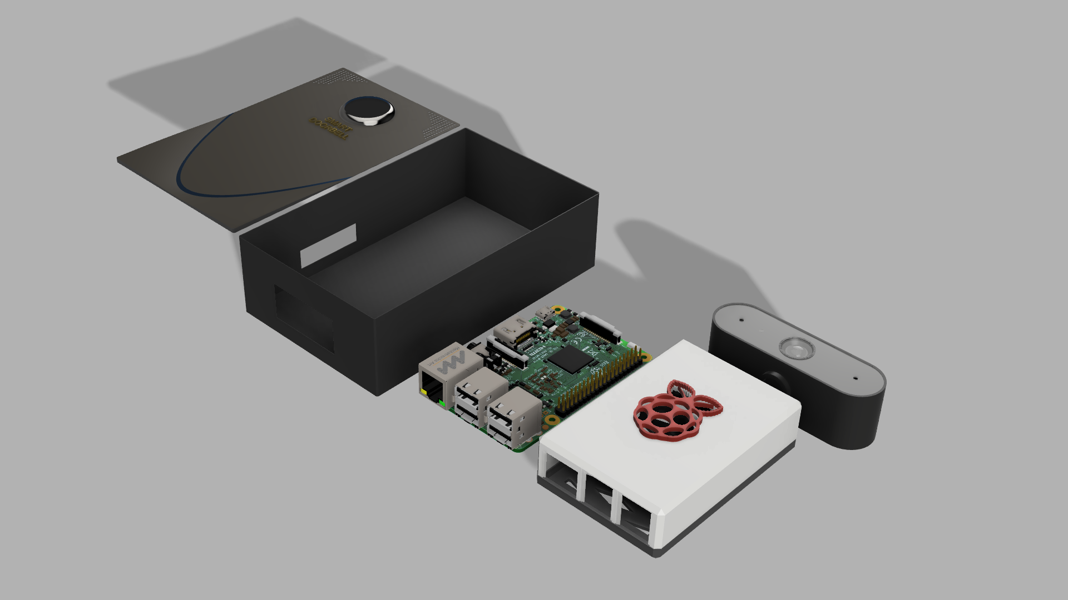
All components of the 3D model

Slide 16
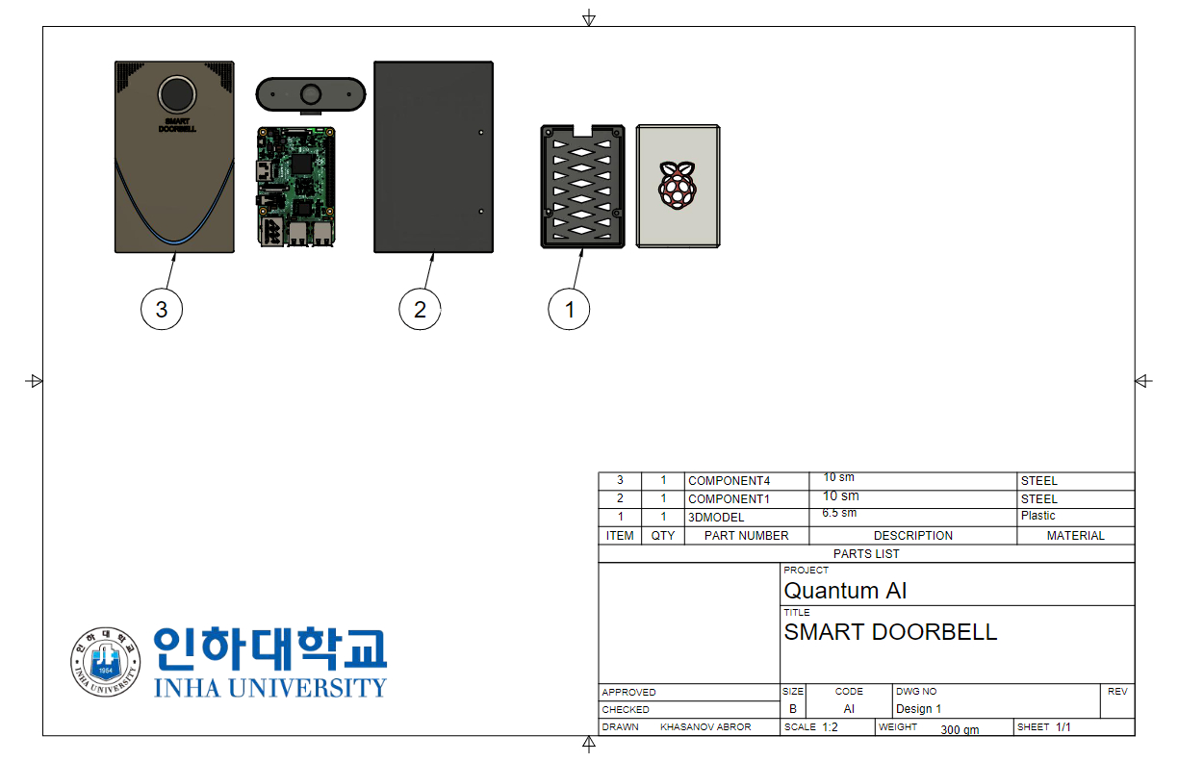
Detailed Drawing of the 3D model

Slide 17
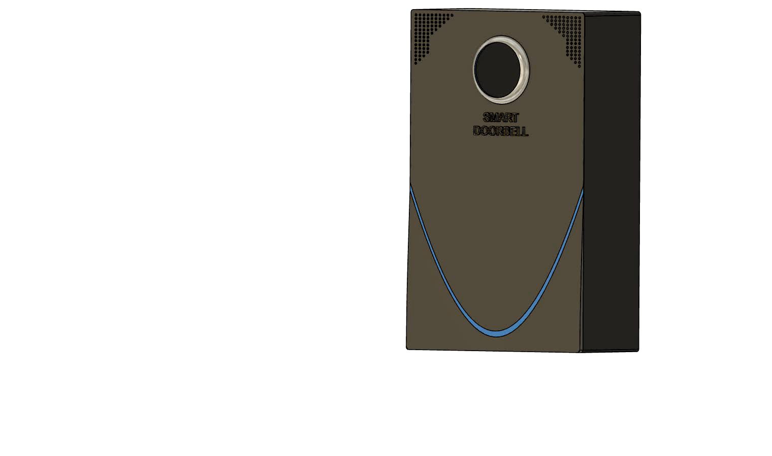
Animated video of the 3D model

Slide 18

Conclusion
Skills that we gained during IOT class
Ability to work with raspberry file
Team work skills
We have learned how to use the raspberry file an how to install it
During the process of creating the application, we have managed to improve out team work skills
Troubleshooting
Better understanding of the Open CV
While creating the application, there were many bugs that we had to take care off. Which means, we had to troubleshoot consistently until the end of the project.
We have learned how to use the open cv by using the camera to detect and recognize person’s face and emotions.

Slide 19
Thank you!
References:
Opencv:
https://github.com/opencv/opencv
Tensorflow:
https://github.com/tensorflow/tensorflow
Cmake:
https://github.com/Kitware/CMake
Face Emotion Recognition lib:
https://github.com/justinshenk/fer
Face Recognition:
https://github.com/ageitgey/face_recognition
Sending Telegram Messages, Telepot:
https://github.com/nickoala/telepot

